Slide 1

Capstone Project Phase B 23-2-D-12
FitFinder Find Your Perfect Workout Partner
Supervisor Prof. Zeev Barzily
Submitters
Aviel Gabay Aviel.Gabay@e.braude.ac.il Omri Gawi Omri.Gawi@e.braude.ac.il

Slide 2
Outline
Introduction
Problem Definition
FitFinder’s Solution
Software Architecture
MVVM Design Pattern
Package Structure
Challenges and Solutions
Project Metrics
Tests
Video of our application

Slide 3
Introduction
Healthy lifestyles and sports engagement are critical for overall well-being. A healthy lifestyle can help reduce the risk of chronic diseases such as obesity, heart disease, and diabetes. Sports also offer a range of mental benefits, including improved self-esteem, better mood, and reduced stress.
In recent times, there has been a growing emphasis on maintaining a healthy lifestyle and engaging in sports. With a plethora of sports and fitness options available today, individuals of all ages are encouraged to pursue their interests in various athletic activities.

Slide 4



Problem Definition
The dispersion of the athletes in different areas makes it difficult for them to find training partners that cater to their specific needs. Many trainees fail to consistently monitor their progress in training, and even trainers have difficulty targeting their audience in a crowded and competitive market.
Challenge of finding suitable training partners
Challenge of tracking progress in training
Challenge in increasing the target audience

Slide 5

FitFinder’s Solution
Android application which:
Connect trainees and trainers by matching system
The matching process is carried out based on the filtered categories (sport category, skill level, distance and workout times)
Monitor progress in training
Track their progress in training by documenting the number of repetitions, exercises.
Allow trainers to display their business pages
Helps trainers increase their target audience by marking their business page as a trainer.

Slide 6
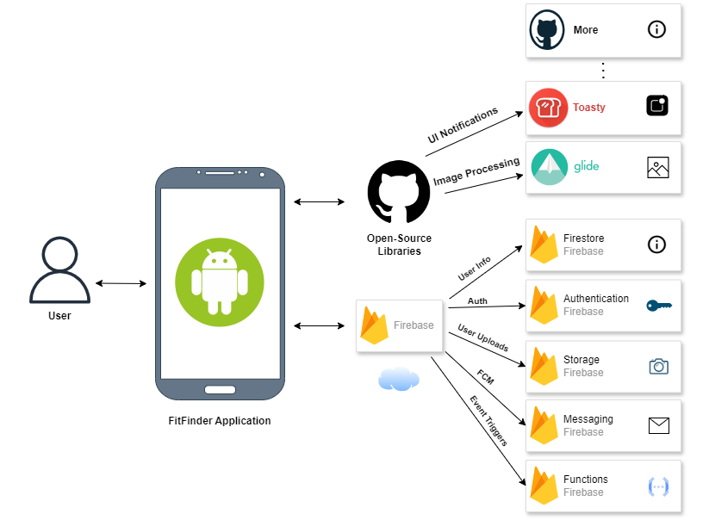
Software Architecture
Users perform various actions like creating an account, searching for trainees, scheduling training sessions, etc.
The application serves as the core of our architecture, processing user requests and facilitating interactions with external services.
Firebase provides backend services. Real-time data services, user Authentication, storing data, etc.
Open-Source libraries for different functionality.

Slide 7
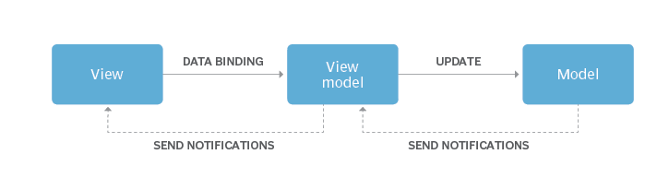
MVVM Design Pattern
Model-View-ViewModel (MVVM) is a structural design pattern that separates objects into three distinct groups: Models, Views, and ViewModels.
Model: Represents data and business logic.
View: Represents the UI
ViewModel: Link between the Model and the View.
Advantages
1. Maintainability
2. Better code readability
3. Improves testability due to its separation of concerns and dependency decoupling.

Slide 8
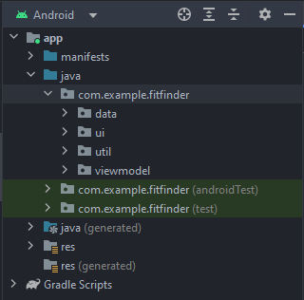
MVVM Design Pattern Package Structure

Slide 9
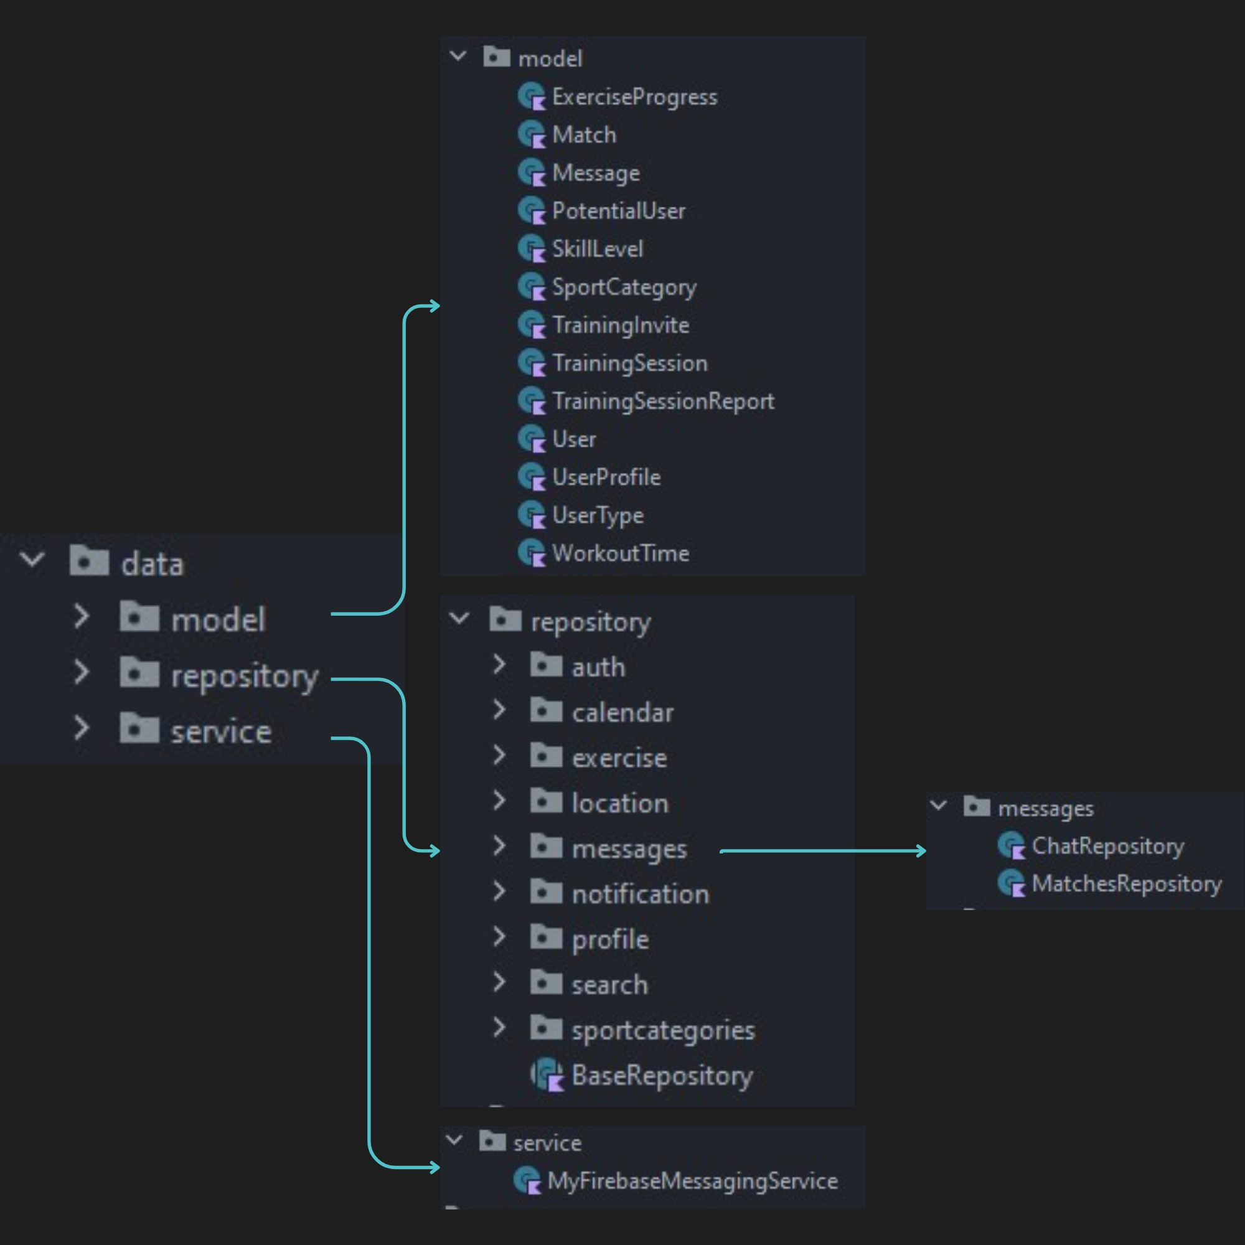
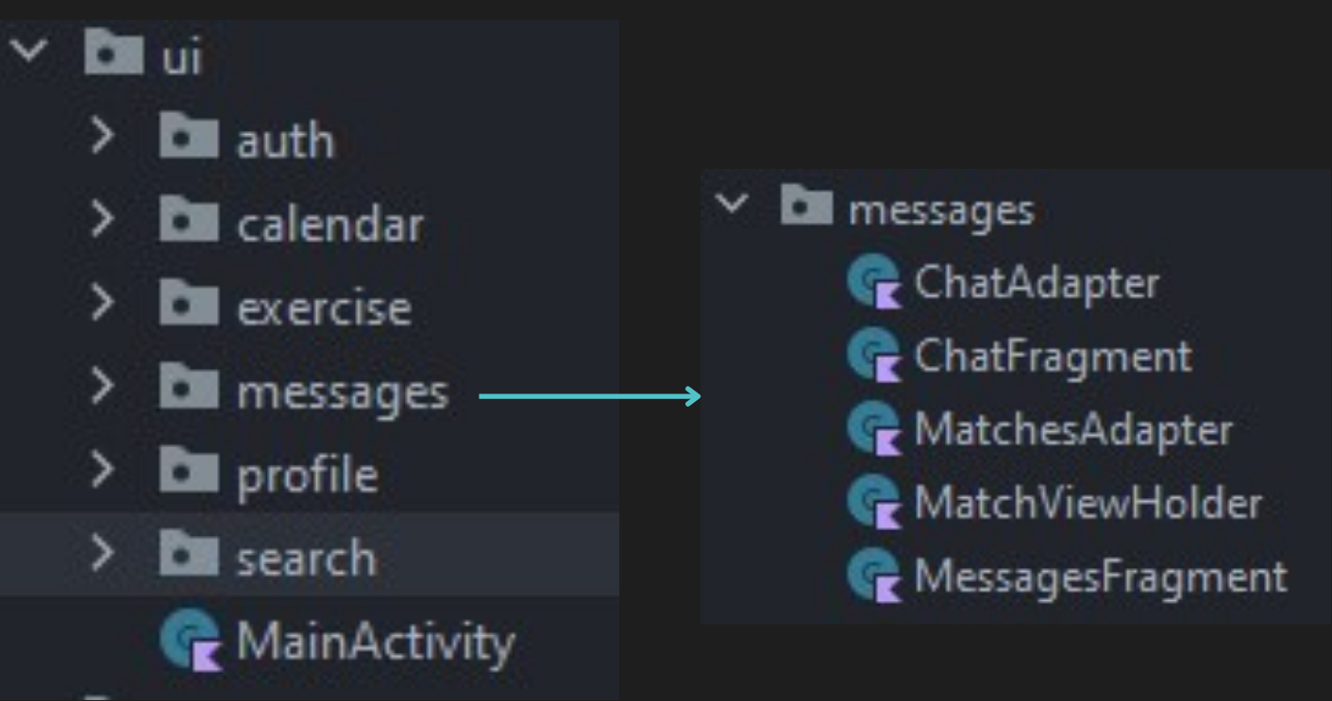
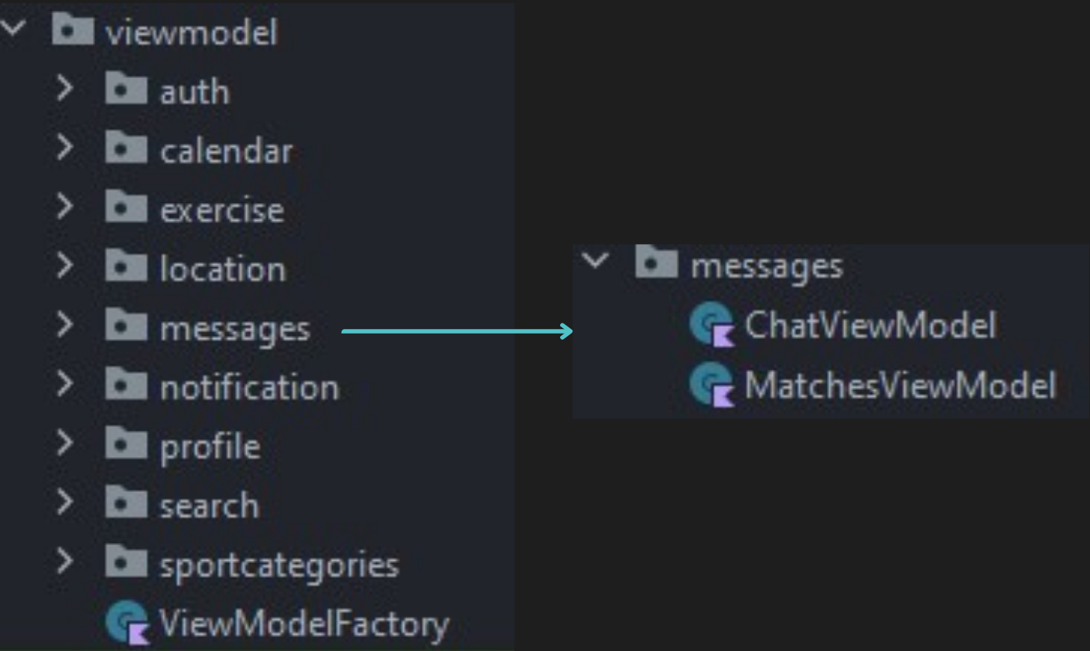
MVVM Design Pattern
Model
View
View-Model

Slide 10
Challenges and Solutions
Database structure
Challenge: Designing the Firebase database structure to minimize data operations.
Solution: Organized the collections based on their relationships and access patterns.
Location service
Challenge: Integrating location services into the application.
Solution: Used FusedLocationProviderClient from the Google Play Services Location API.
UI experience
Challenge: Designing an intuitive user interface.
Solution: We asked friends and family to use the app on different devices and provide us with feedback.

Slide 11


Project Metrics
Deepen our understanding of Android development
Functionality of the application
Implementing MVVM Design pattern
Tablets & iOS devices
User authentication
User profile
Matching system
Real-time messaging
Notifications
Training sessions
Reports
Training progress
Android Lifecycle
LiveData
Coroutines
Navigation

Slide 12
Tests
During the development of FitFinder, we conducted manual acceptance testing to ensure that the application met the specified requirements and was ready for the end-user. The acceptance testing process involved verifying the app’s navigation against the acceptance criteria defined for each feature.
Navigation between all screens & navigation bar
Functionality

Slide 13

Thank you for listening!
Do you have any questions?

